Slide 1
Italy

Slide 2
Emblem
Flag

Slide 3
Flag - First Italian tricolor was born on 7 January 1797 in Emilia as the flag of the Republic, proclaimed Giuseppe Compagnoni. During the reign of Napoleon's flag was also used as a symbol of the French revolution. Emblem - The official emblem of the Italian Republic was promulgated by the President of Italy Enrico de Nicola on may 5, 1948.The logo includes a white five-pointed star with red edges superimposed on the cog wheel with five spokes, standing between an olive branch to the left and oak on the right. Green branches tied together with a red ribbon with the words "Italian Republic" (ital. REPUBBLICA ITALIANA) in capital white letters.

Slide 4
Italy [iˈtaːlja]- officially the Italian Republic (Italian: Repubblica italiana), is a unitary parliamentary republic in Southern Europe. Italy covers an area of 301,338 km2 (116,347 sq mi) and has a largely temperate climate; due to its shape, it is often referred to in Italy as lo Stivale (the Boot). With 61 million inhabitants, it is the 5th most populous country in Europe. Italy is a very highly developed country and has the third largest economy in the Eurozone and the eighth-largest in the world.

Slide 5
Italy - decentralized unitary state. The state capital is Rome. The country is divided into 20 regions :Valle d'aosta, Lombardy, Trentino Alto Adige, Friuli-Venezia Giulia, Piedmont, Liguria, Veneto, Tuscany, Umbria, Emilia-Romagna, Marche, Abruzzo, Lazio, Molise, Basilicata, Campania, Calabria, Apulia, Sardinia and Sicily (of which 5 - Sicily, Sardinia, Trentino-Alto Adige, Valle d'aosta and Friuli-Venezia-Giulia - have a special status) , including as an administrative-territorial unit 110 provinces.

Slide 6
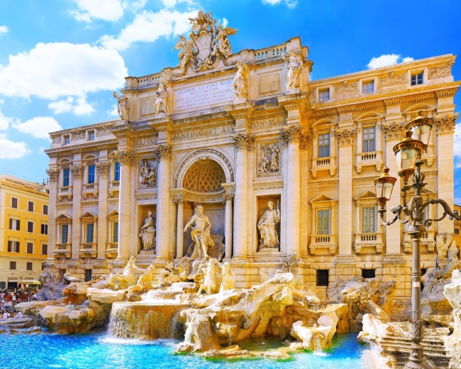
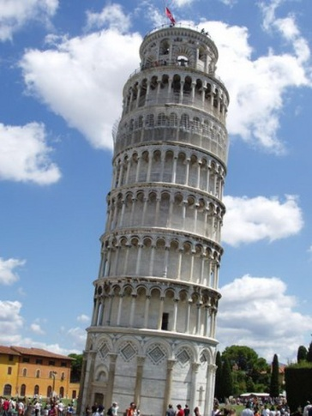
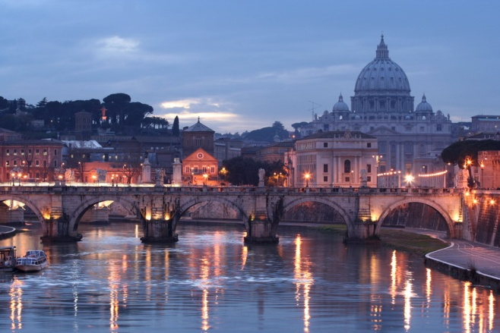
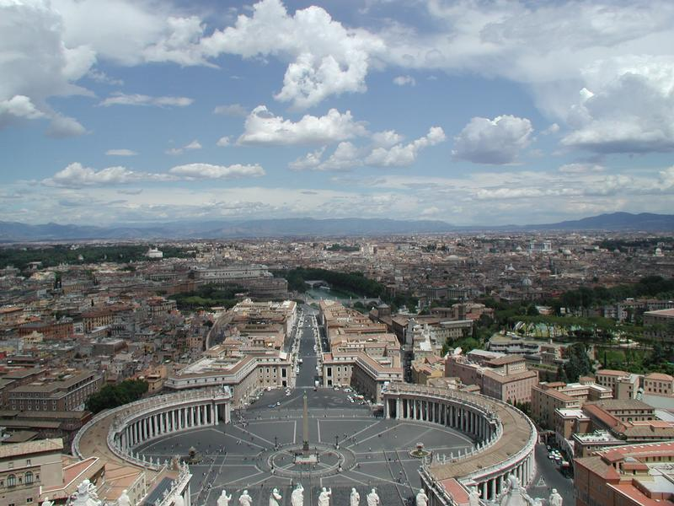
Rome is the capital of Italy Rome, a settlement around a ford on the river Tiber conventionally founded in 753 BC, grew over the course of centuries into a massive empire, stretching from Britain to the borders of Persia, and engulfing the whole Mediterranean basin, in which Greek and Roman (and many other) cultures merged into a unique civilisation. The Roman legacy has deeply influenced the Western civilisation, shaping most of the modern world.[39] In a slow decline since the third century AD, the Empire split in two in 395 AD. The Western Empire, under the pressure of the barbarian invasions, eventually dissolved in 476 AD, when its last Emperor was deposed by the Germanic chief Odoacer, while the Eastern half of the Empire survived for another thousand years.

Slide 7
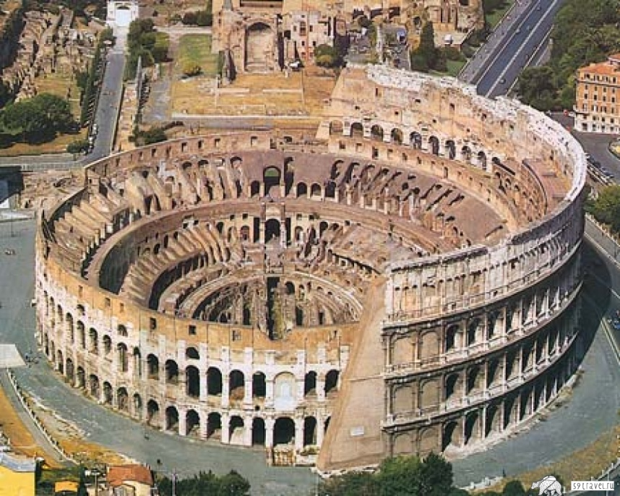
The Colosseum in Rome, built c. 70 – 80 AD, is considered one of the greatest works of Roman architecture and engineering.

Slide 8
History Ancient Rome -To start of I Millennium BC South and centre of Italy was inhabited by the italic peoples, one of which was latina. Latina formed the Latin Union, which included 30 civitatem, controls each of which was the people's Assembly . After the Sunnite wars to 290 Rome set in dependence on all other italic peoples. Part of the land narimskogo population of the provinces were transferred to the Romans, was based Roman settlements - colonies - thus was the romanisation of Italy. Under the Roman Emperor Diocletian in Italy was introduced division into provinces, at the head of which stood preside and consulary. After the fall of the Roman Empire in 476 by the king of Italy was proclaimed commander Odoacer, but in 493 year, his estates were seized by the Ostrogoths, and he was killed.

Slide 9
The middle ages In 555 year Italy was conquered by Byzantium. The whole territory of Italy was divided into Duchies, headed by the Dukes, who was formally subordinate Exarch of Ravenna. In 572 year part of the Duchies of Italy were conquered by the Lombards. For Byzantium remained of the Roman Duchy, the Duchy of Naples, the Amalfi Duchy, the Duchy of Calabria, Duchy of Pentapolis, the Exarchate of Ravenna and the Venetian Republic, as well as FEMA Sicily (conquered by the Arabs in 956 year) and the Sardinian judicata. However, Lombard and Byzantine Dukes increasingly turned into a de facto independent rulers. In the year 752 in the Roman Duchy, the Exarchate of Ravenna and Pentapolis was established the temporal power of the popes, which marked the beginning of the Papal States. In 774 year Italy was conquered by the Frankish Kingdom, just to the South survived several Lombard Duchies (Spoleto Duchy, the Duchy of Benevento, and later one of them stood out the Principality of Salerno and the Principality of Capua). In the year 800, the Frankish king Charlemagne was proclaimed himself the new Roman Emperor. After the death of his grandson Charles III in Italy started the feud.

Slide 10
In 951 year the king of Italy was proclaimed German king Otto I. However, the power of the king of Italy was nominal, the whole area of Northern Italy was divided into brand - Tuscany (Toscana), Friuli (later - Verona (Veneto), Evreiskoi (was soon joined the Turin brand), Saluzzo, Monferrato, Turin (all four in Piedmont), Milan (Lombardy). The brand was ruled by the electors, each of which was in fact a sovereign ruler. However, in the XI-XII century the majority of the brands split into communes, representing an aristocratic city-state. Tuscan brand completely collapsed, the Verona brand was acquired by Venice, Turin brand was attached to the Savoy in 1091, from previous grades remained only Saluzzo and Monferrato. In some Tuscan communes were periodically increased democratic elements. In 1071, Norman nobleman Robert Quicker conquered Apulia and Calabria, in 1072 Sicily, in 1073, Amalfi, in 1078 Salerno, formed the Duchy of Apulia and Calabria and the County of Sicily, who in 1130 United Kingdom of Sicily. In 1135 under his power passed the Principality of Capua, in 1140 - Duchy of Gaeta, in 1144 year - Duchy of Naples. Simultaneously, and Papal - in 1081 joins the Duchy of Benevento, and in 1201 - Duchy of Spoleto.

Slide 11
The Renaissance By the fifteenth century the commune of Tuscany were United around Florence in the Grand Duchy of Tuscany, Lombardy was United around Milan in the Duchy of Milan, the region was United around Ferry in Verarsche Duchy, all these States was a monarchy. Venice and Genoa remained an aristocratic Republic. In the XVI century in large parts of Italy entrenched the dominance of Spain, after the war of the Spanish succession 1701-1714 - the domination of the Austrian Habsburgs. In 1797 in Italy entered the French army, were formed Cispadana Republic, Transparency Republic, the Republic of Venice, the Ligurian Republic, Piedmont, Republic, Roman Republic, the Neapolitan Republic, all were oligarchic republics. In the same year 1797, they were United in the Cisalpine Republic, renamed in 1802 Italian Republic, which, in turn, in 1805, was transformed into the Kingdom of Italy, the king of which was the French Emperor Napoleon I. In 1814, the French army left Italy, were restored to the Duchy of Modena, Duchy of Parma, the Kingdom of Naples and the Papal States were restored even 1799, the Kingdom of Sardinia was returned to Piedmont, Emilia Papal States, Lombardy and Veneto Austria.

Slide 12
New time The struggle for a unified Italy was led by Carbonari, "Young Italy" and other organizations, key figures in which were Giuseppe Garibaldi and Giuseppe Mazzini. By the end of 1860 territory of Italy was mainly centered around the Kingdom of Sardinia (1861 the Kingdom of Italy), in 1870 the Italian Kingdom was annexed Rome.

Slide 13
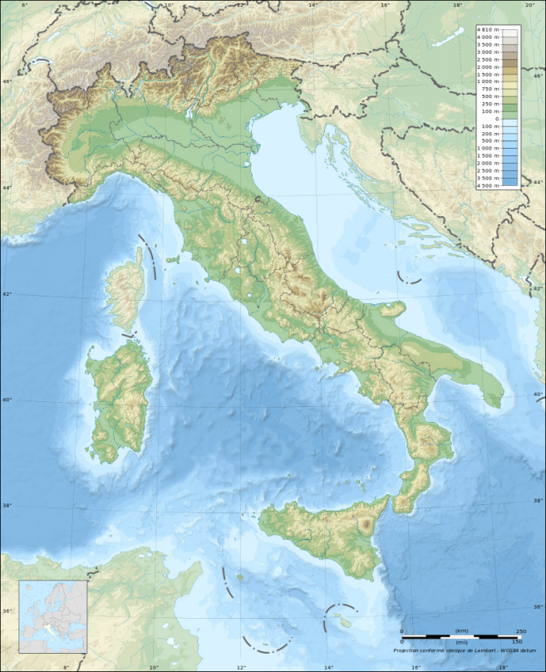
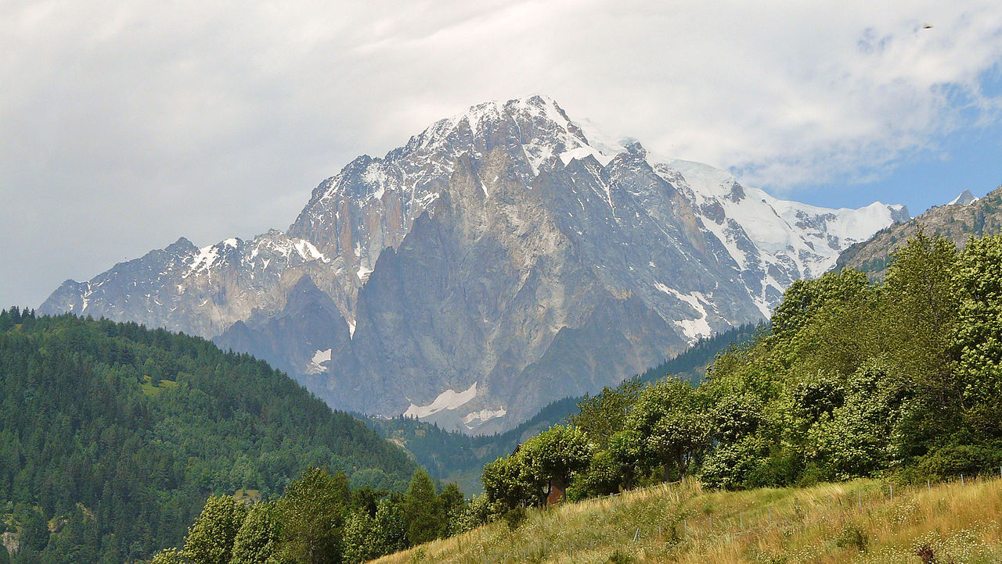
Geography Italy is a predominantly mountainous country. On the North - South slopes of the Alps with the highest point in Western Europe, Mont Blanc (4808 m), South of the Po plain; on the Peninsula, the Apennine mountains (the highest point is mount Corno Grande, 2914 m). The Apennine mountains are divided into: Ligurian, Tuscan-Emilian, Umbro-Marckie, Abruzzian Rocks, Lucan, Calabrian Apennines and Monti Sabini[it]. Even in the Eastern part of the Peninsula is a Peninsula of Gargano, in the South-East and South-West of the Peninsula Salentina and Calabria, respectively. Active volcanoes (Vesuvius, Etna); frequent earthquakes.

Slide 14
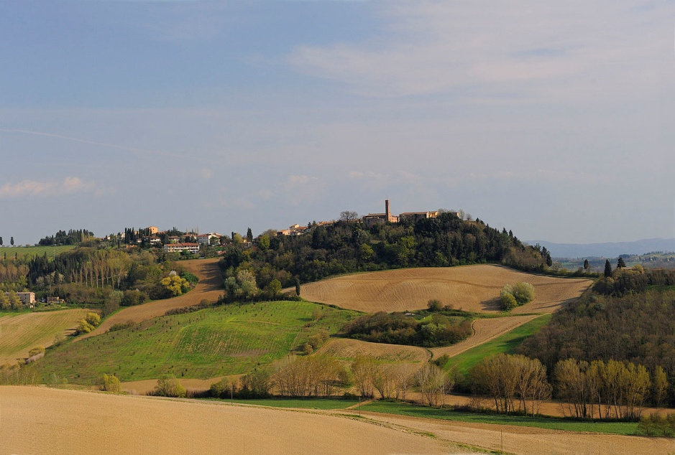
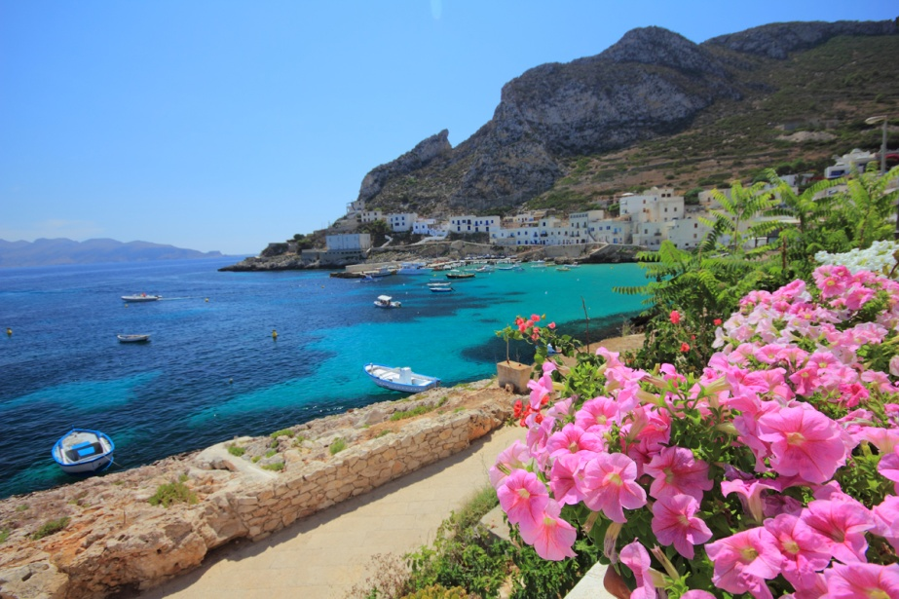
Washing of the sea from the East the Peninsula is washed by the Adriatic sea to the Gulf of Venice in its Northern part. The Otranto Strait between Apulia and Albania connects the Adriatic sea with the Ionian. Between Apulia and Calabria are deeply embedded in the Gulf of Taranto land. Very narrow Strait of Messina separates from Calabria and Sicily (or Tunisian) wide Strait of 135 km from Sicily from North Africa. Tyrrhenian sea basin is triangular in shape, edged with Sardinia, Corsica, Tuscan archipelago, the Apennine Peninsula and Sicily. To the North of Corsica is the Ligurian sea with the Gulf of Genoa. In the North-Eastern part of the island of Sicily are Nebrodi mountains and in the South-Western part of the island of Sardinia plain Campidano[en]. A large part of the small Islands divided into archipelagos, such as the Tuscan archipelago, which includes the island of Elba, which was exiled Napoleon Bonaparte. The longest river of Italy, its length - 682 km Largest lake Garda.

Slide 15
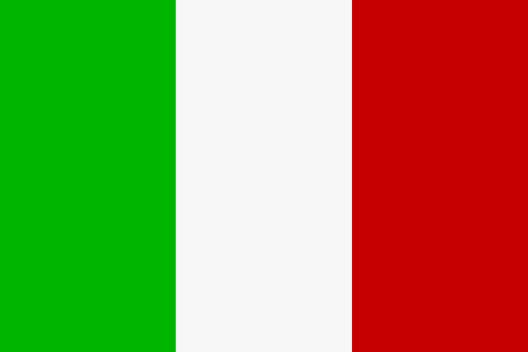
Climate Thanks to the great longitudinal extension of the peninsula and the mostly mountainous internal conformation, the climate of Italy is highly diverse. In most of the inland northern and central regions, the climate ranges from humid subtropical to humid continental and oceanic. In particular, the climate of the Po valley geographical region is mostly continental, with harsh winters and hot summers. The coastal areas of Liguria, Tuscany and most of the South generally fit the Mediterranean climate stereotype (Köppen climate classification Csa). Conditions on peninsular coastal areas can be very different from the interior's higher ground and valleys, particularly during the winter months when the higher altitudes tend to be cold, wet, and often snowy. The coastal regions have mild winters and warm and generally dry summers, although lowland valleys can be quite hot in summer. Average winter temperatures vary from 0 °C (32 °F) on the Alps to 12 °C (54 °F) in Sicily, like so the average summer temperatures range from 20 °C (68 °F) to over 30 °C (86 °F).
The work of Shcherbakov Ivan student 10 "А" class

