Slide 1
Презентация на тему: “Space needle”

Slide 2
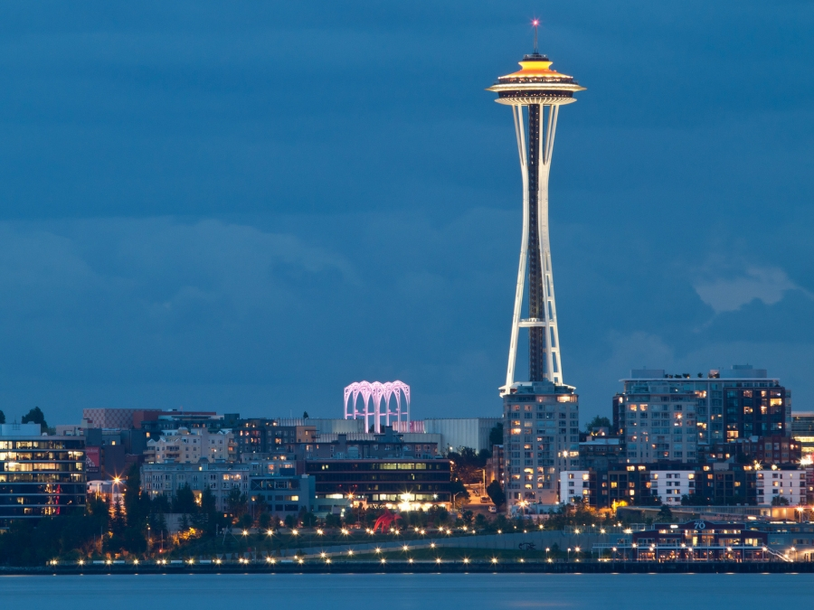
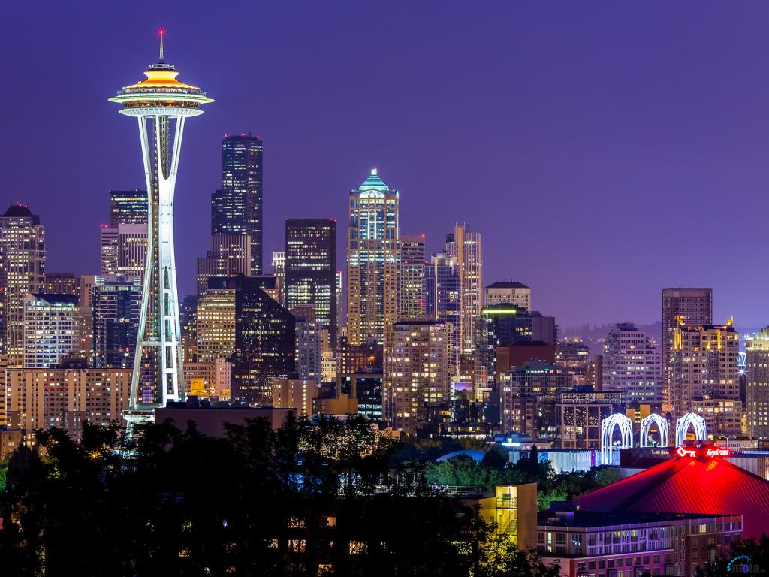
Space Needle - the most recognizable landmarks in the northwest Pacific coast of the United States and a symbol of Seattle.

Slide 3
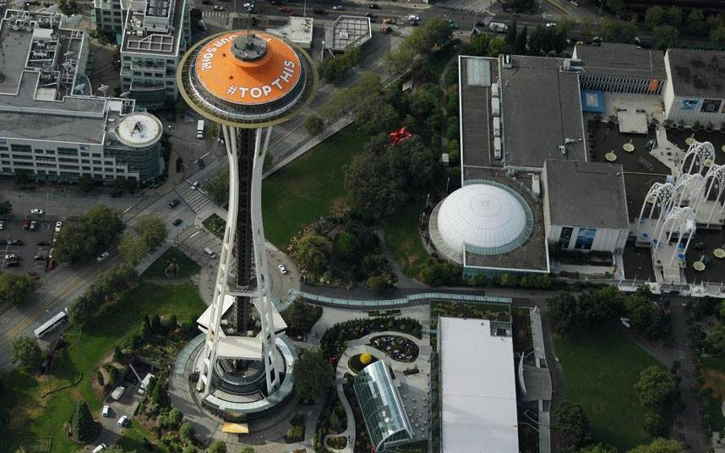
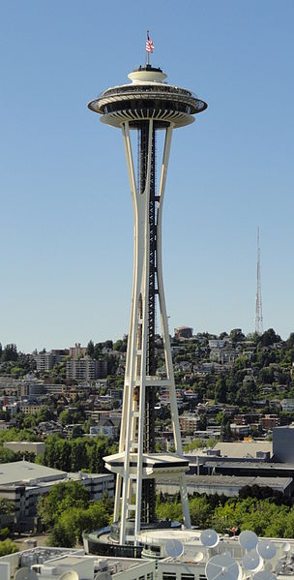
Tower in futuristic style "Googie" located on the Exhibition Grounds Seattle Center, which was built for the 1962 World's Fair, during which about 20 thousand people a day climbed the tower; 2.3 million visitors - only during the World Expo. Now the tower is privately owned.

Slide 4
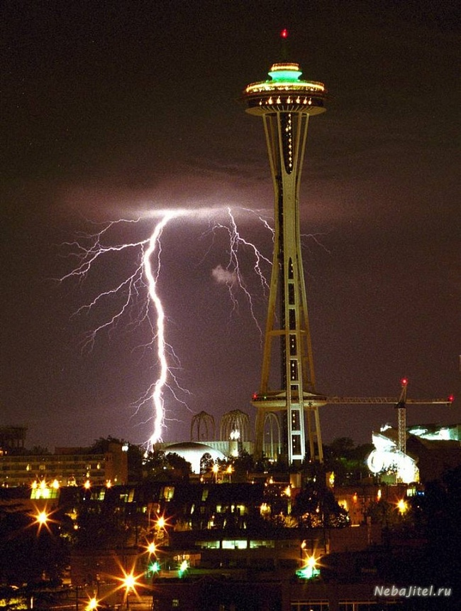
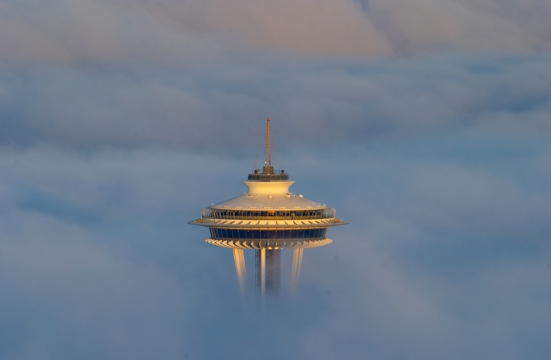
Спейс Нидл — башня 184 метра высотой и 42 метра шириной в самой широкой точке и весом 9 550 тонн. Она построена так, что выдерживает ураганы со скоростью ветра до 320 км/ч и землетрясения до 9,1 балла; башня оборудована 25 громоотводами^{[1]}.

Slide 5
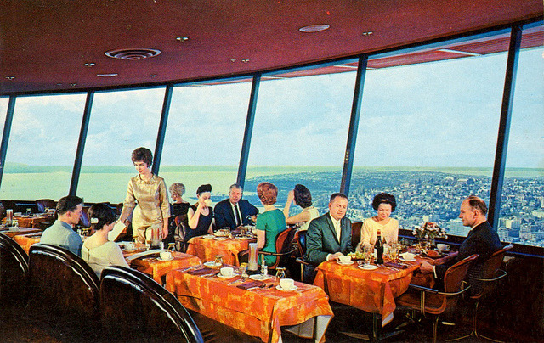
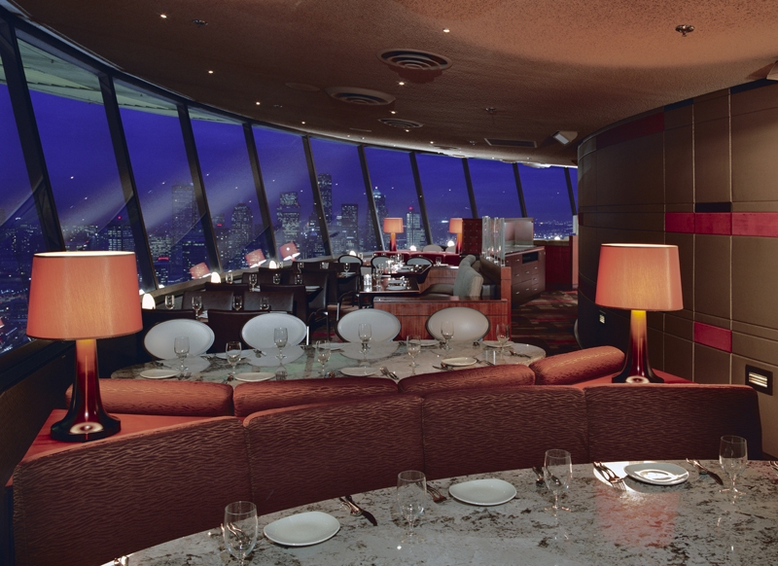
Feature of the tower is a viewing platform at a height of 159 meters, a restaurant SkyCity (Heavenly City) and a gift shop. From the top of the tower you can see not only the center of Seattle, but also the Cascade Mountains and Mount Rainier, Elliott Bay and surrounding islands.

Slide 6
Panoramic views of downtown Seattle and Elliott Bay at dusk with the Space Needle

Slide 7
Презентацию подготовили ученики 10-Б класса: Лукинов Захар, Дмитрий Ефремов, Никита Янченко

