Slide 1
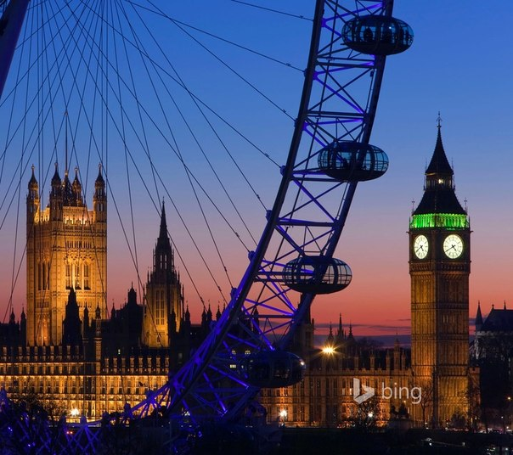
London

Slide 2
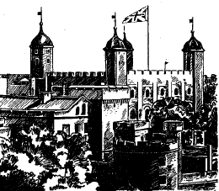
London, the capital of Great Britain, is a very old town. It is two thousand years old. Many years ago London was a small town on the Thames. There were a lot of villages round it and after many years London and three hundred villages grew into a very large city. Some of the names of those villages you can find in the names of the streets in modern London — Kensington, Westminster and others. There were many wars in those days and people from other countries came to Great Britain and destroyed London, but new houses of stone grew up. London stands not far from the sea. Many ships from other countries came to the port of London and brought cotton, food and other things. Factories grew in London and other cities. Many shops were opened in the centre of London. In 1863 the first underground railway began to work. It was very short in those days. Now London is a beautiful city with large squares and parks. London is one of the biggest cities in the world.

Slide 3
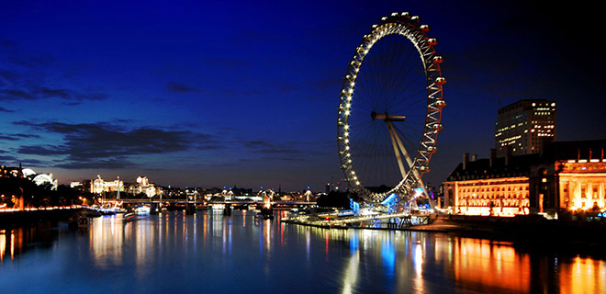
The London Eye
The London Eye is the major feature of London’s skyline. It consists of thirty-two capsules each holding up twenty-five people. For breathtaking experience and unforgettable view of more than fifty London’s famous landmarks you have just to climb aboard and take a thirty minute ‘excursion’.

Slide 4
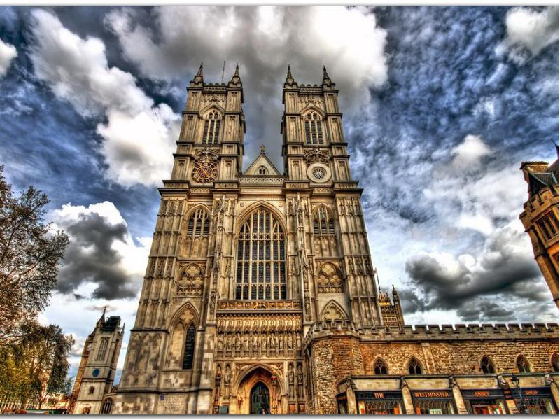
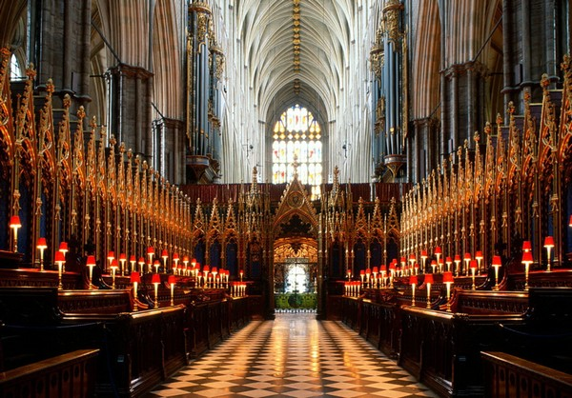
Westminster Abbey
Westminster Abbey also knows as Collegiate Church of St. Peter is a Gothic church on the scale of a cathedral. Westminster Abbey has been the traditional place of coronation and burial for English monarchs for a long time. Today it is still used for the celebration of great events in the country’s history and for regular worship.

Slide 5
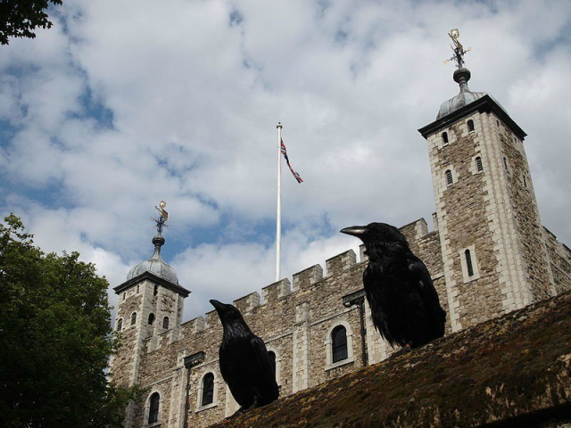
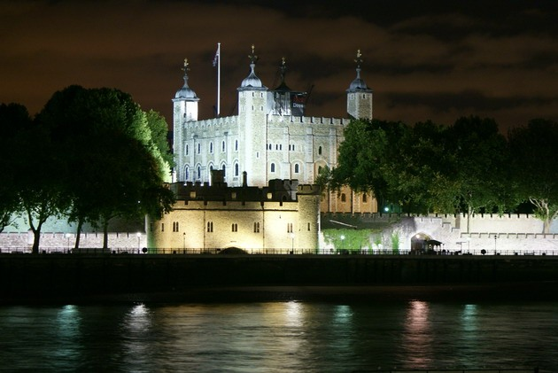
Tower of London
The greatest Tower of London is one of the world’s most famous buildings. This building with 900-years history was previously a royal palace, execution place, prison, jewel house, arsenal and even zoo. While visiting this sight don’t forget to gaze up at the White Tower, marvel at the Crown Jewels and skulk through a medieval king’s bedchamber.

Slide 6
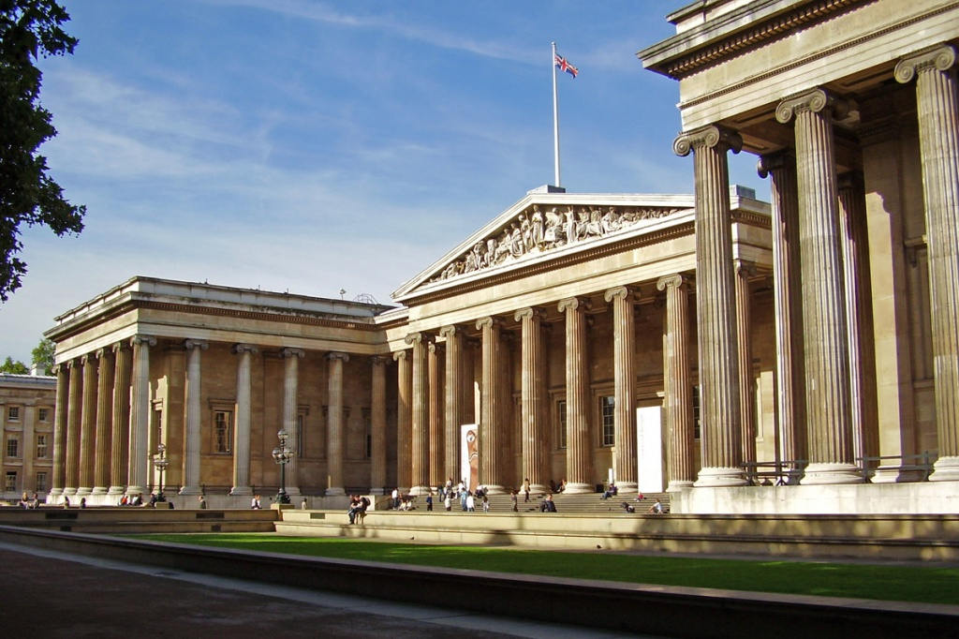
The British Museum
The British Museum is one of the most famous museums in the world with the richest collections. It exhibits man works from all over the world from prehistoric period to modern times. The most famous exhibits of the British Museum are the Parthenon Sculptures, the Rosetta Stone, the mummies of Ancient Egypt. The entry to the museum is free but for several special exhibitions you need tickets.

Slide 7
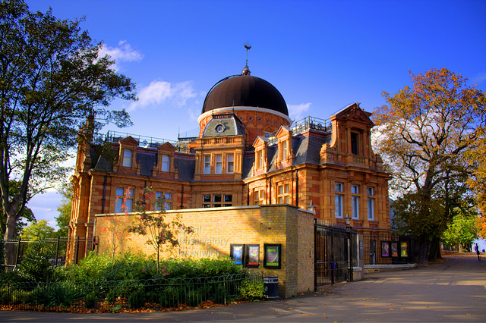
The Royal Observatory, Greenwich
It is situated 10 miles outside London on a hill above the River Thames. The Observatory contains telescopes and displays about astronomy, including Halley's Comet and Black Holes. There is a video theatre and a souvenir shop. Picnic in Greenwich Park. You can take a river boat to Greenwich from Westminster Bridge.

Slide 8
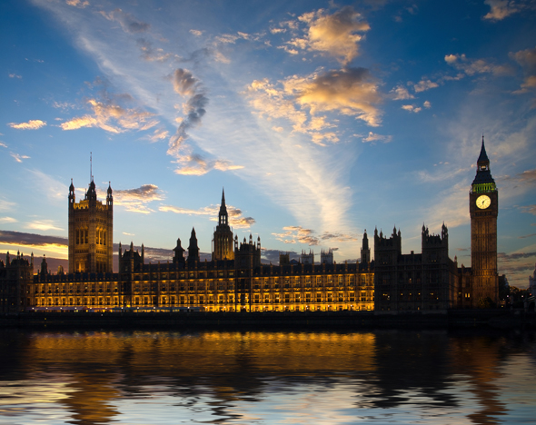
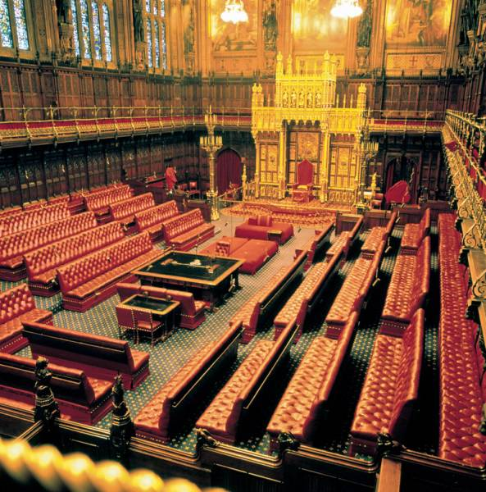
The Houses of Parliament
Its official name is the Palace of Westminster. Most of the building was built in 1840 after the fire of 1834 destroyed the old palace. At the north end of the building, by Westminster Bridge, there is the famous clock tower, Big Ben. In fact Big Ben is really the name of the bell in the tower, not of the clock.

Slide 9
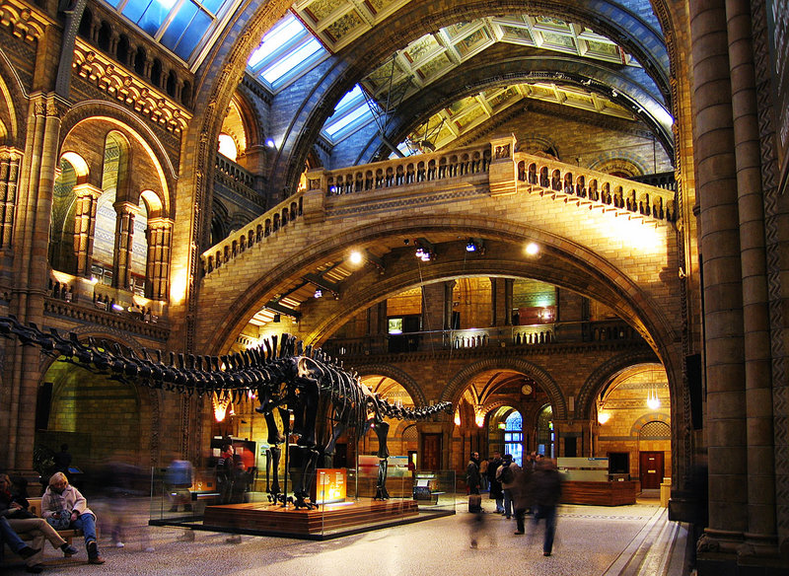
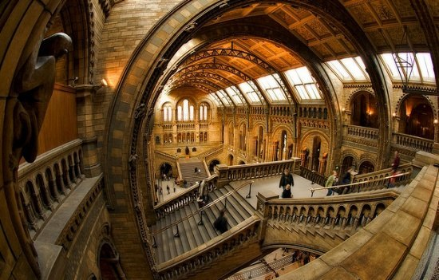
The Natural Museum
It's situated in Kensington and is one of London's greatest museums. There is a huge collection of animals and plants, including a quarter of a million butterflies, a blue whale and the famous dinosaur skeletons. There is a cafeteria, a gift shop, and a book shop.

Slide 10
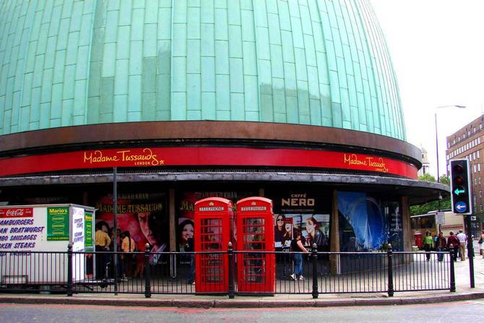
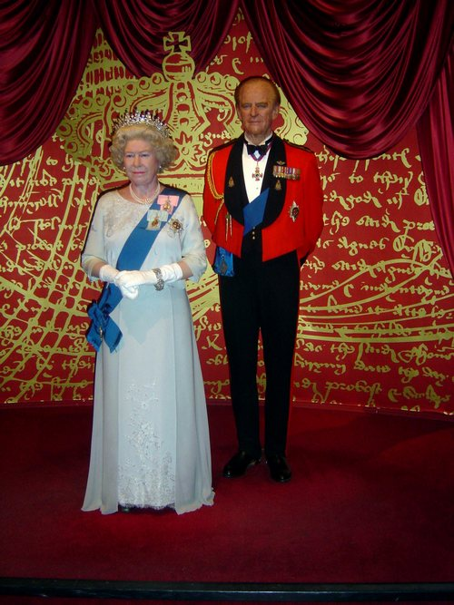
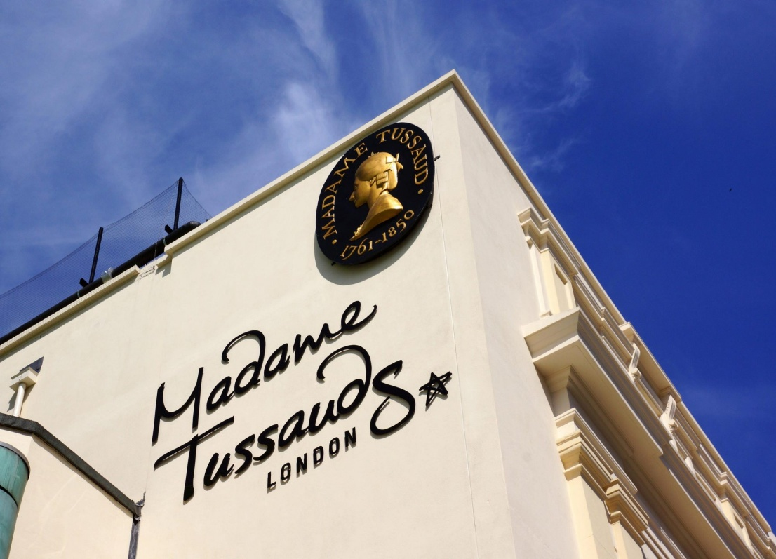
Madame Tussauds, Morylebone Road
The famous Waxworks Museum has the models of famous people from pop stars to prime ministers, displays of battles and a Chamber of Horror.

Slide 11
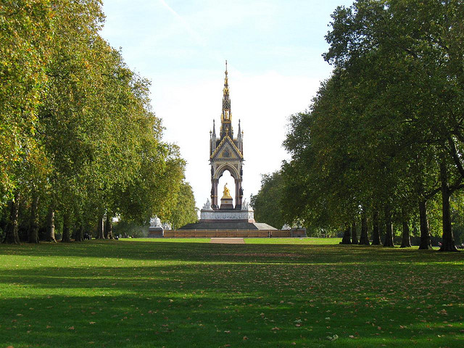
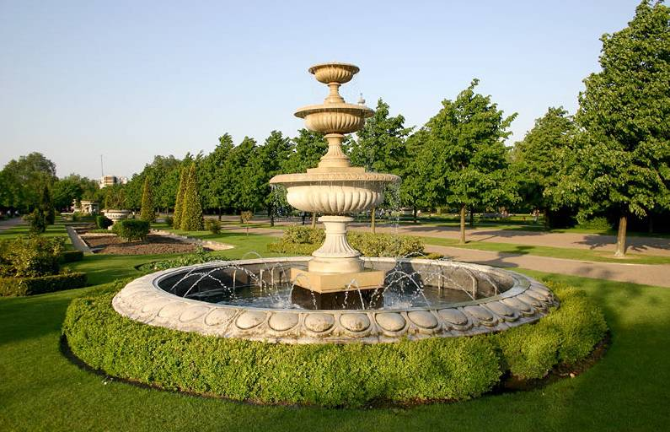
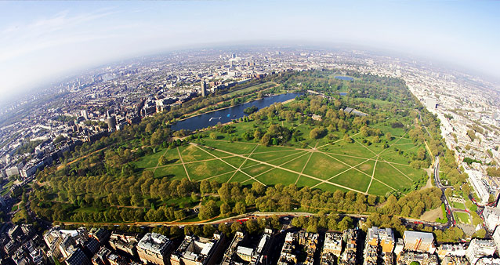
Hyde Park
It's the London's largest and most fashionable park. It was once a royal hunting forest. There are restaurants and bars at each end of the Serpentine lake. Hire a boat.

Slide 12
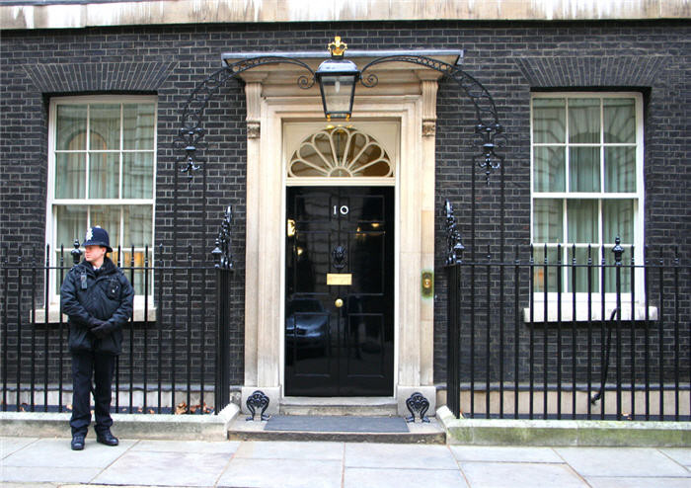
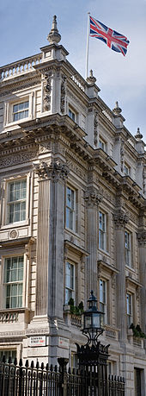
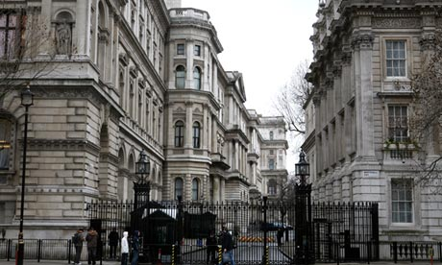
Downing Street
Number 10, Downing Street has been the home of the British Prime Minister since 1735.

Slide 13
The End!!!

