Slide 1
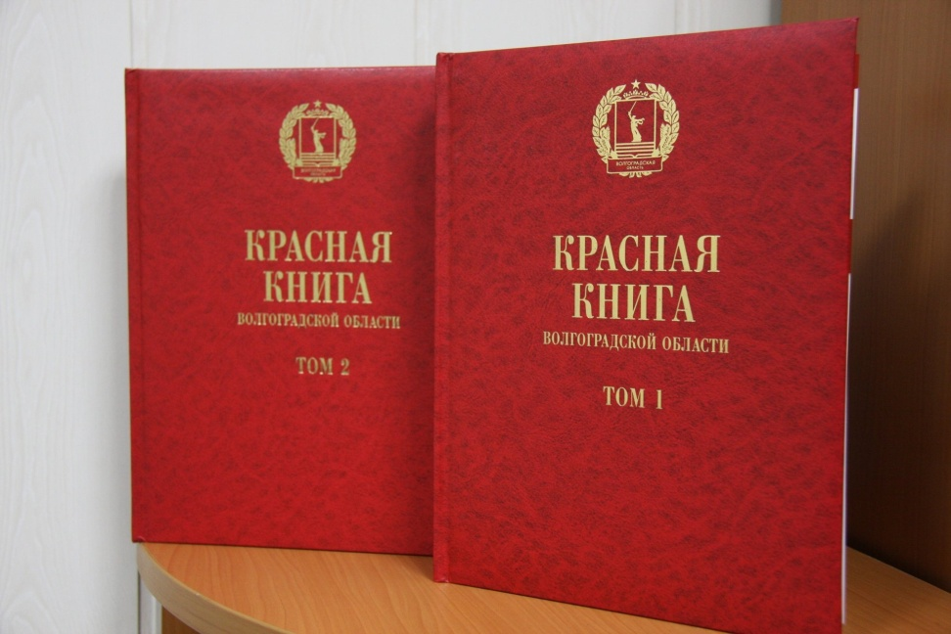

RED BOOK : animals and plants
Authors: Timofey Rodin, Sergey Kirsanov, Timofey Gurtovoy

Slide 2
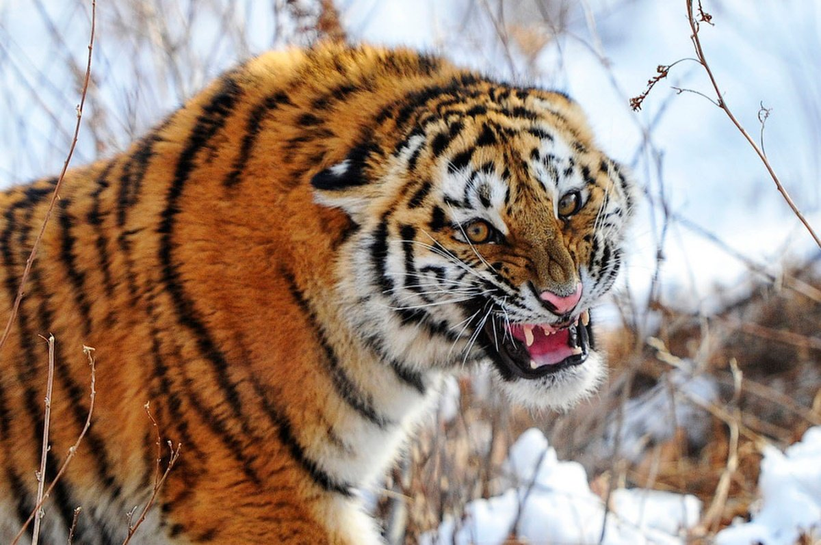
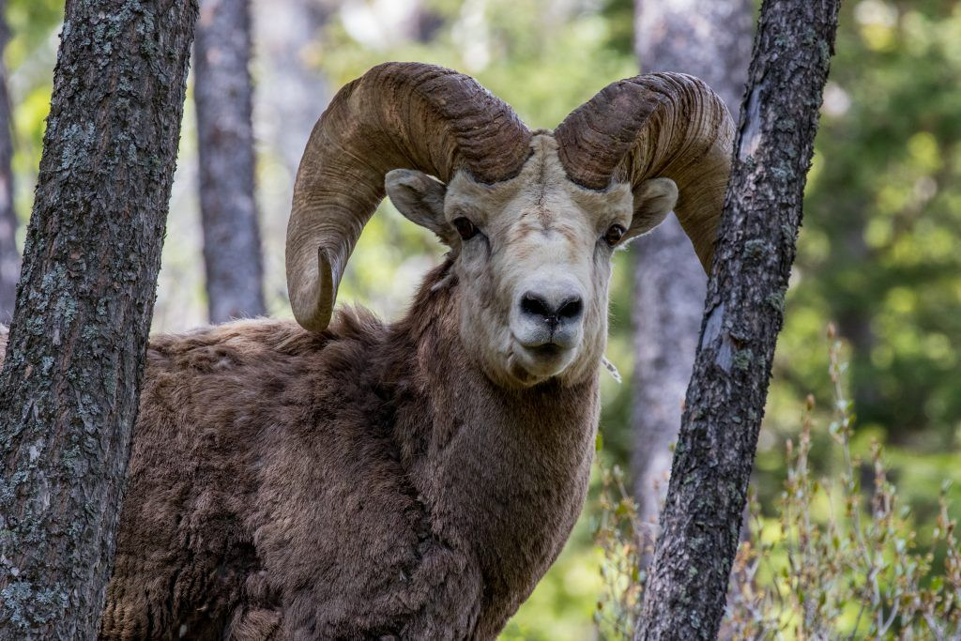
Animals in the red book

Slide 3
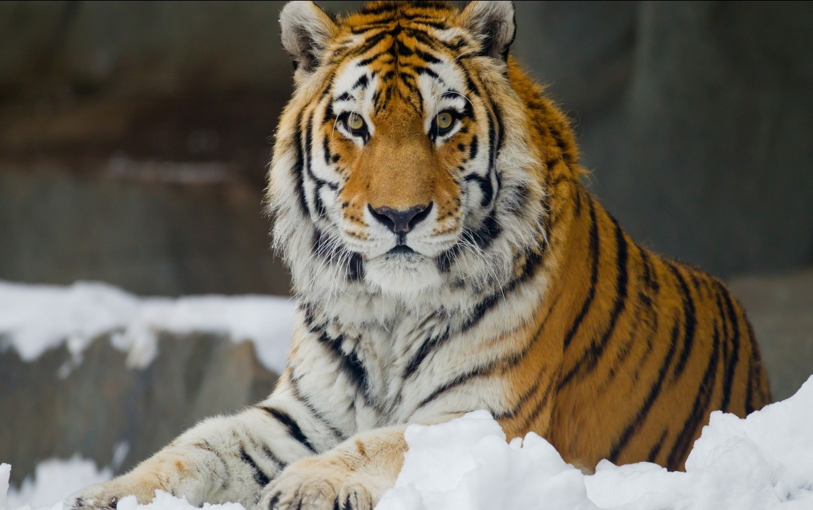
Amur tiger
Amur tiger. Speaking of this far Eastern king of animals, living in the Ussuri forest, it should be noted that among the animals of the red Book of Russia a lot of names of representatives of feline. Amur tiger is the largest and the only species of tiger that has mastered life among the crystal-white snow and low temperatures.

Slide 4
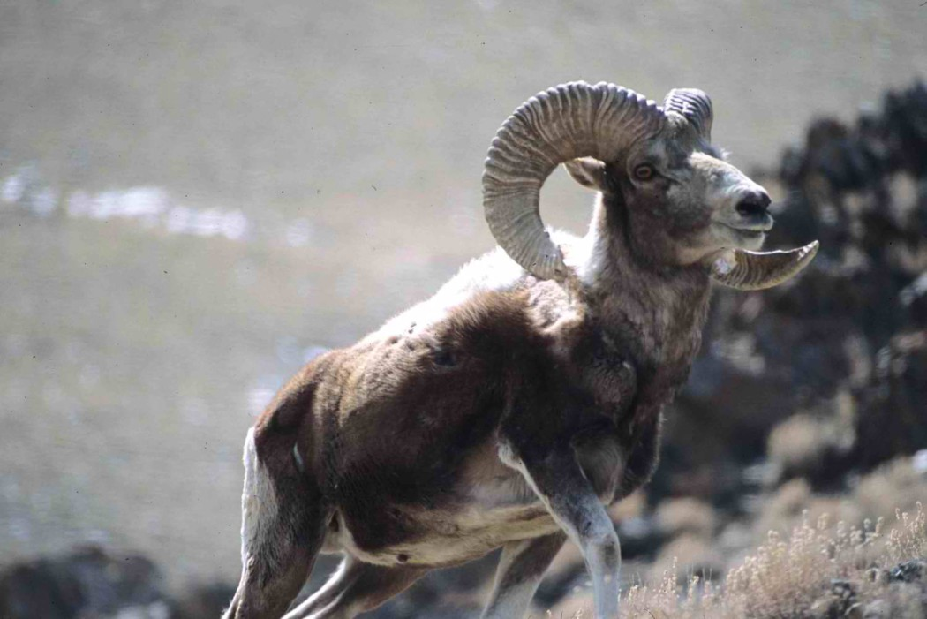
Altai mountain sheep
Altai mountain sheep is the owner of the largest horns of all representatives of the genus

Slide 5
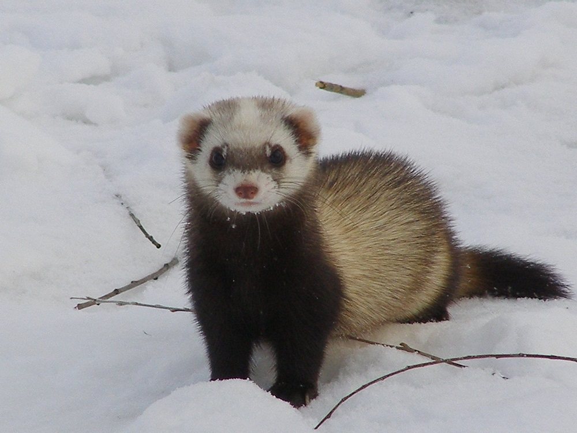
Amur Steppe Horus
Amur Steppe Horus has a very low population, and since the 50s the risk of extinction is only growing.

Slide 6
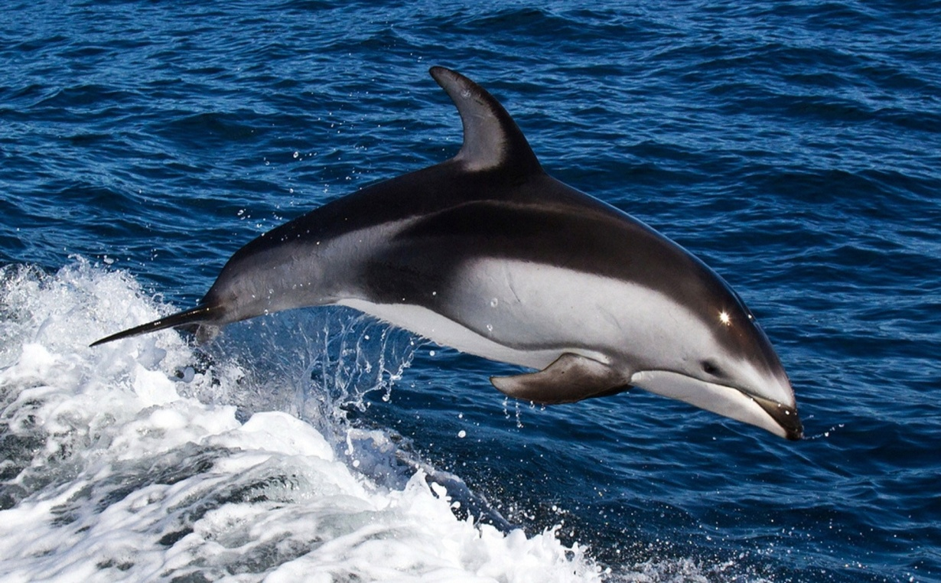
White-haired Dolphin
White-haired Dolphin. The main difference between the Atlantic white-haired Dolphin is a large white or beige spot, starting on both sides of the dorsal fin and stretching along the entire body.

Slide 7
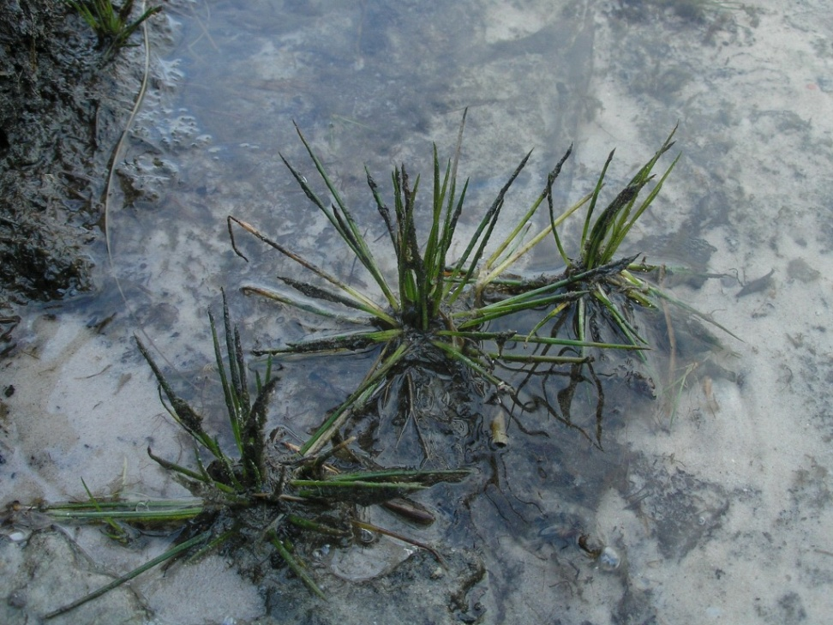
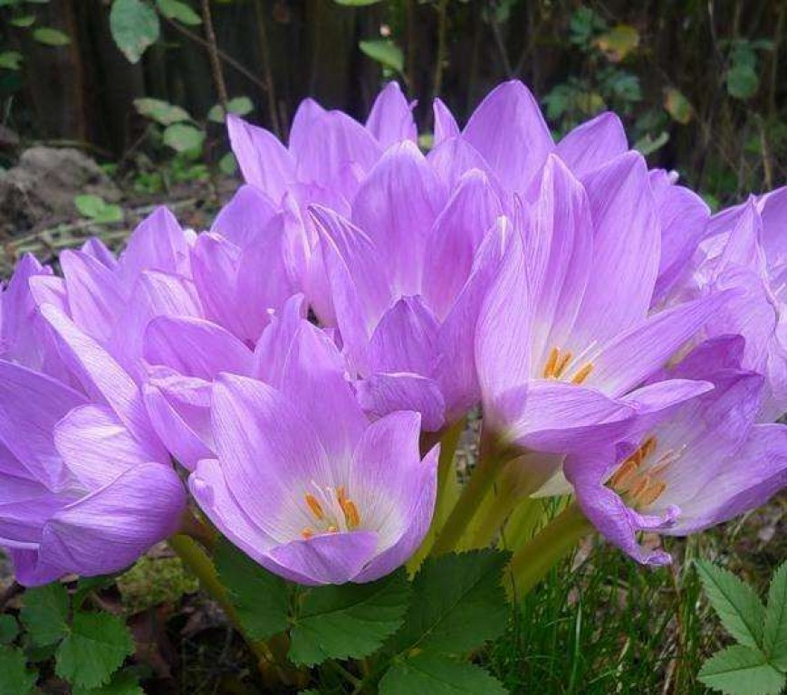
Plants in the red book

Slide 8
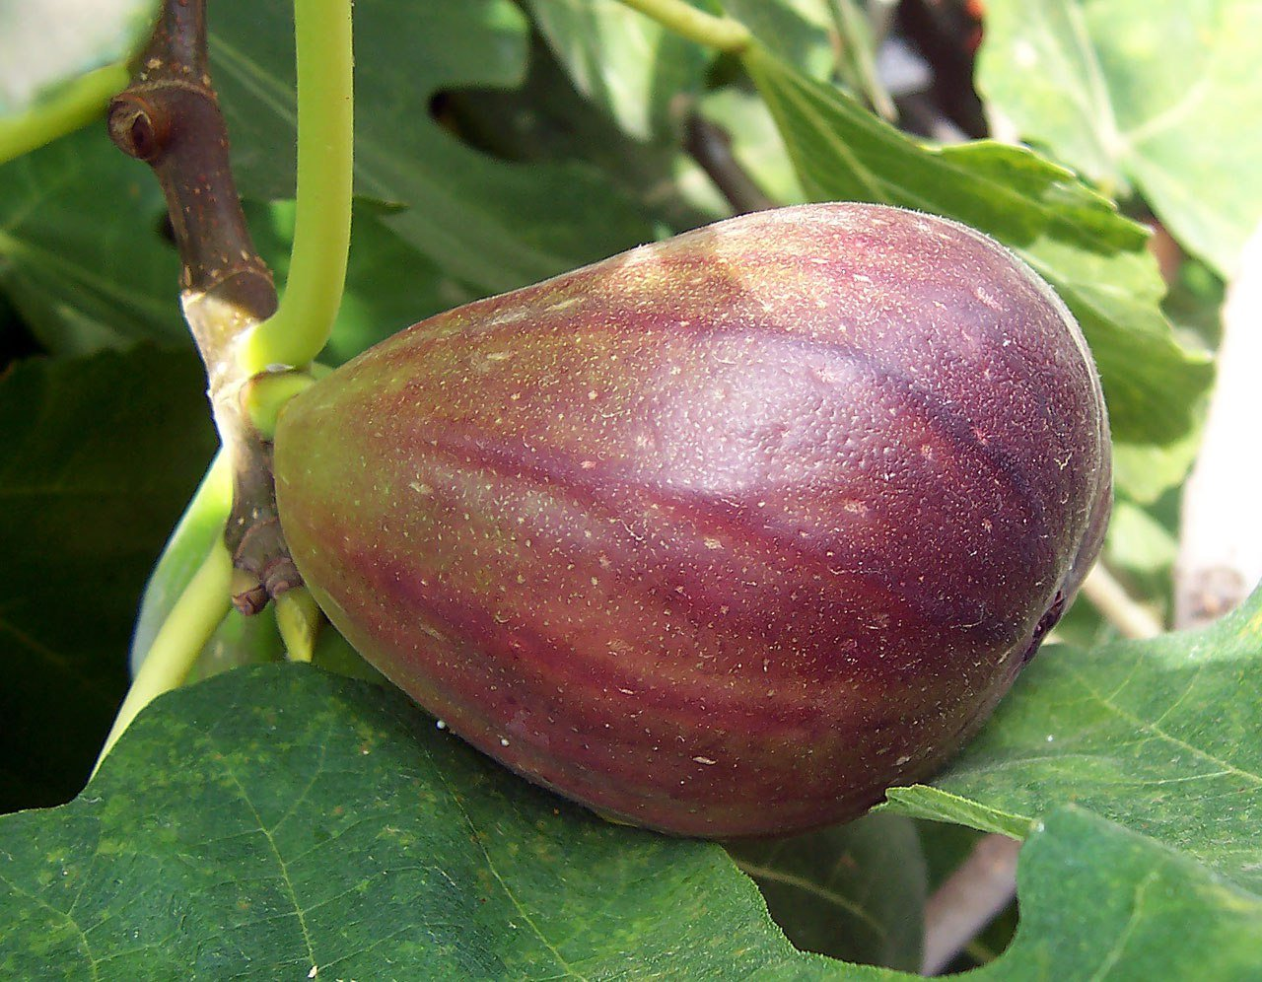
Common figs
Fig is a shrub or fruit tree of the Mulberry family (Moraceae Link), subtropical deciduous ficus. The height of the plant reaches 15 m.

Slide 9
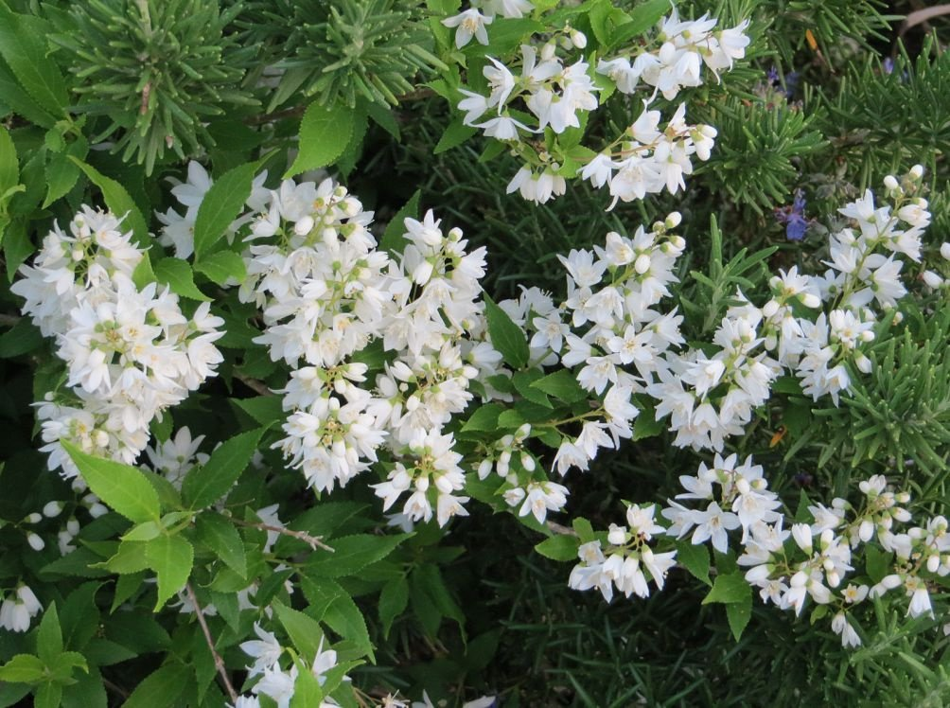
Action smooth
Action smooth-is quite rare, protected plant. It loves light and is extremely sensitive to the soil fertility. Most often found in forests, particularly in mixed and deciduous, and prefers shady or moist slopes of the rocks

Slide 10
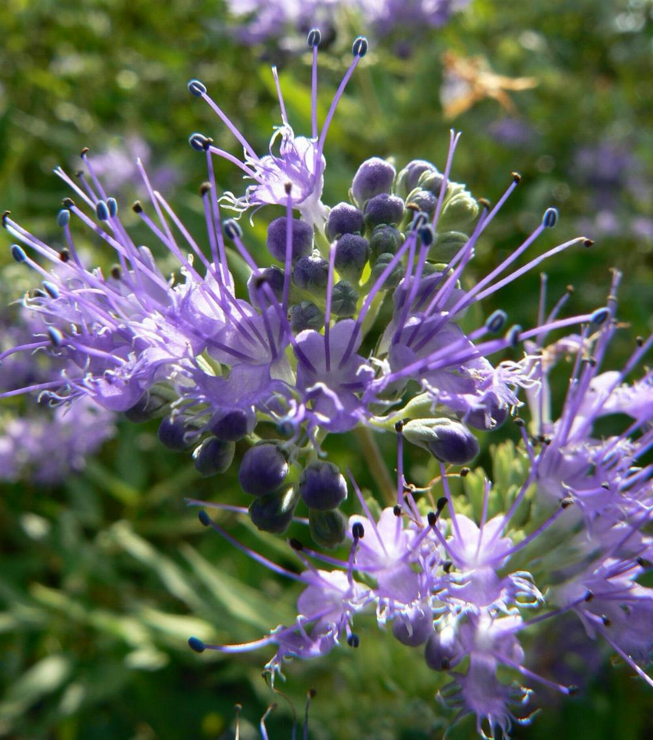
The Nutcracker Mongolian
Mongolian hazelnut-belongs to the category of specially protected plants. Externally, it is a semicircle, which grows no more than half a meter in length.

Slide 11
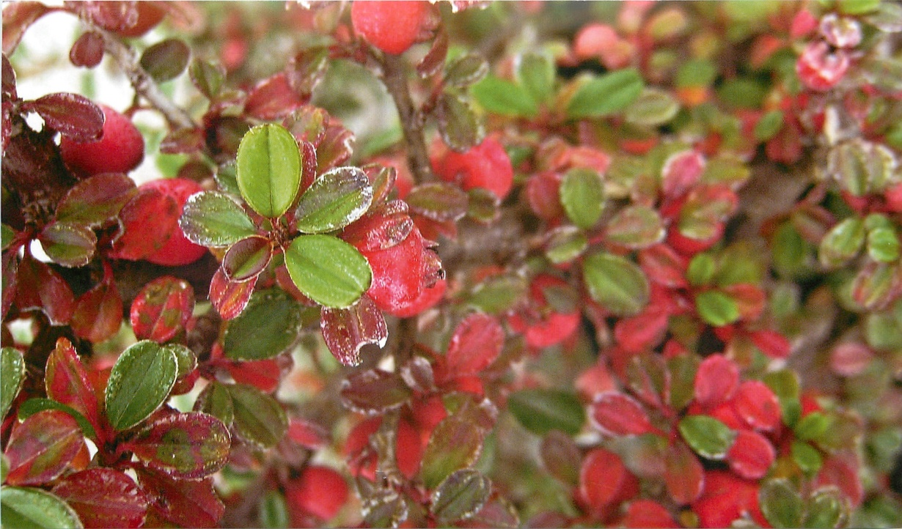
Cotoneaster Kinopanorama
Deciduous shrub up to 1 m tall. or pressed to the ground the trees were growing. Life expectancy is several decades. Vegetative mobility is extremely weak. Dominated by seed regeneration.

Slide 12
Thank you for listening!

