Slide 1
Victory Day
МБОУ «Родионово-Несветайская СОШ №7»
Разработчики
Ученицы 8 «Г» класса :
Янченко Елизавета
Матилян Маринэ.

Slide 2
Задачи урока:
расширение кругозора обучающихся;
приобщение их к литературному наследию родной страны;
показать интерес к военной истории нашей страны англичан;
повышение их интереса к предметам «русская литература» и «английский язык».

Slide 3
Цель урока :
объединить учеников с разным уровнем знаний английского языка в совместной творческой работе, раскрыть их индивидуальные творческие способности.

Slide 4
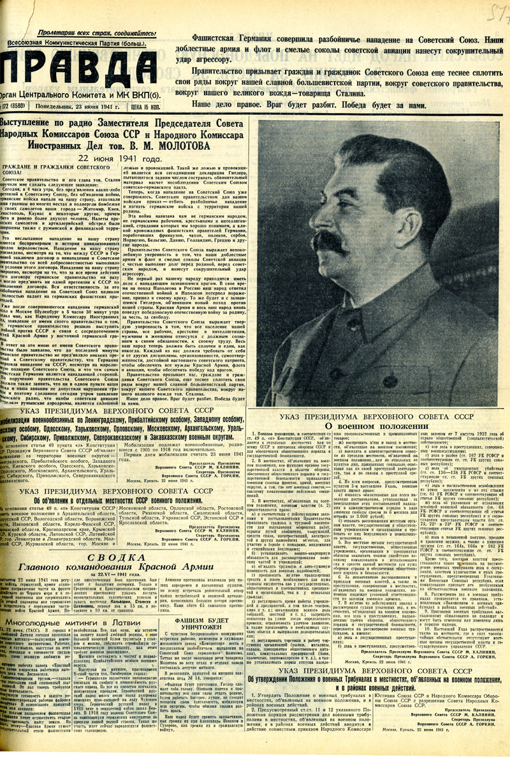
The term Great Patriotic War appeared in the Soviet newspaper Pravda soon after Nazi Germany invaded the Soviet Union

Slide 5
Victory Day is a great holiday in the Soviet Union and in many other countries. On this day millions of people celebrate the victory over the German fascists x in 1945. On the 9th of May Soviet people and their leaders receive many greetings from differ­ent parts of the world. It is because the Soviet Union and its army fought for all countries which were attacked by the fascists.
Today the working people of the world thank the USSR and its Communist Party for the struggle in the name of peace.
That day is celebrated by meetings and marches. People bring flowers to the monuments where war heroes lie.
We listen to what war veterans2 tell about the war and how they fought for victory.
The veterans think: «The young people must not forget the heroes, they must be ready to defend their country against all enemies.»
Then flowers and souvenirs are given to those who took part in the Great Patriotic War.
In the evening there is a holiday salute and a minute of silence4 to remember all those who did not come back from the war.
On the TV holiday concert songs of the Great Patriotic War are sung. War veterans also сome to take part in the programmes and tell how they fought for their country and how they live now.
On Victory Day we not only remember the past. We must think about the future and defend piece.

Slide 6
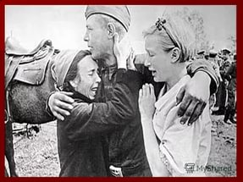
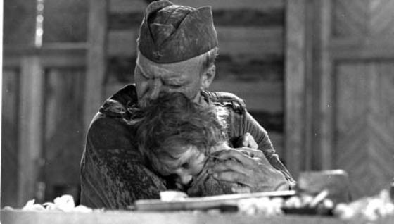
The Great Patriotic War is a huge emotional distress for many people. It’s hard to find a family in our country which didn’t lose somebody in this awful war.

Slide 7
The main steps of Great Patriotic War
Beginning of the war
22.06.1941
Moscow battle
December, 1941
Stavropol battle
June – July, 1942
Stalingrad battle
July – February, 1942 – 1943
Battle at the Arc of Kursk
July – August, 1943
Liberation of Leningrad, Odessa, Kerch, the Crimea
1944
The End of the GPW
9 May 1945

Slide 8
Operation Barbarossa
Operation Barbarossa (German: Unternehmen Barbarossa) was the code name for Nazi Germany's invasion of the Soviet Union during World War II that began on 22 June 1941. It was the largest military offensive in history. In addition to the large number of troops, it also involved 600,000 motor vehicles and 750,000 horses. Planning for Operation Barbarossa started on 18 December 1940; the secret preparations and the military operation itself lasted almost a year, from spring to winter 1941.
Barbarossa's operational goal was rapid conquest of the European part of the Soviet Union west of a line connecting the cities of Arkhangelsk and Astrakhan, often called the A-A line. Adolf Hitler had not achieved the expected victory, but the Soviet Union's situation remained dire. Tactically, the Germans had won some resounding victories and occupied some of the most important economic areas of the country, mainly in Ukraine. Despite these successes, the Germans were pushed back from Moscow.
Operation Barbarossa's failure led to Hitler's demands for further operations inside the USSR, all of which eventually failed.

Slide 9
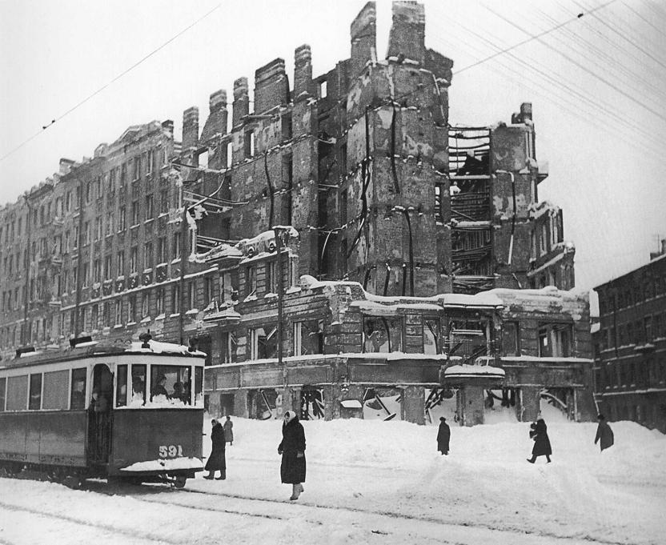
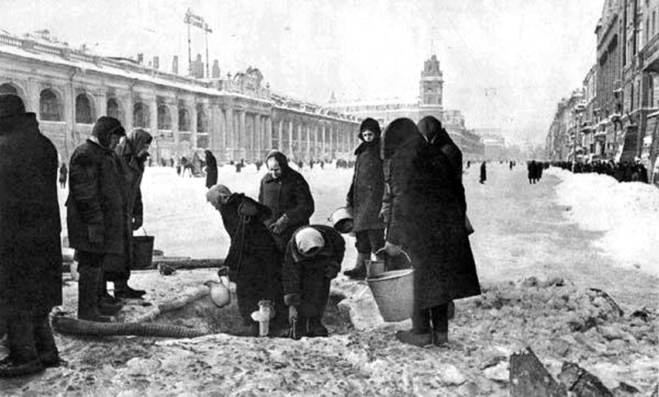
the Leningrad Blockade
This was undoubtedly the most tragic period in the history of the city, a period full of suffering and heroism. For everyone who lives in St. Petersburg the Blokada (the Siege) of Leningrad is an important part of the city's heritage and a painful memory for the population's older generations. The siege lasted for a total of 900 days, from September 8, 1941 until January 27, 1944. The city's almost 3 million civilians (including about 400,000 children) refused to surrender and endured rapidly increasing hardships in the encircled city. Food and fuel stocks were limited to a mere 1-2 month supply, public transport was not operational and by the winter of 1941-42 there was no heating, no water supply, almost no electricity and very little food. In January 1942 in the depths of an unusually cold winter, the city's food rations reached an all time low of only 125 grams (about 1/4 of a pound) of bread per person per day. In just two months, January and February of 1942, 200,000 people died of cold and starvation in Leningrad . Despite these tragic losses and the inhuman conditions the city's war industries still continued to work and the city did not surrender.

Slide 10
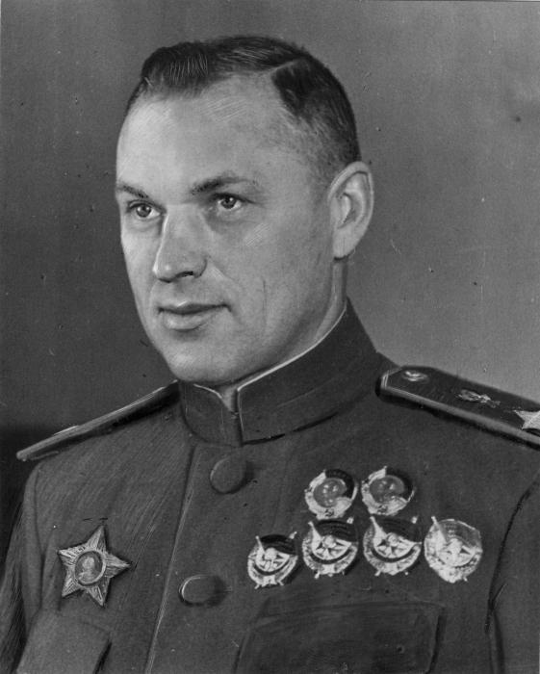
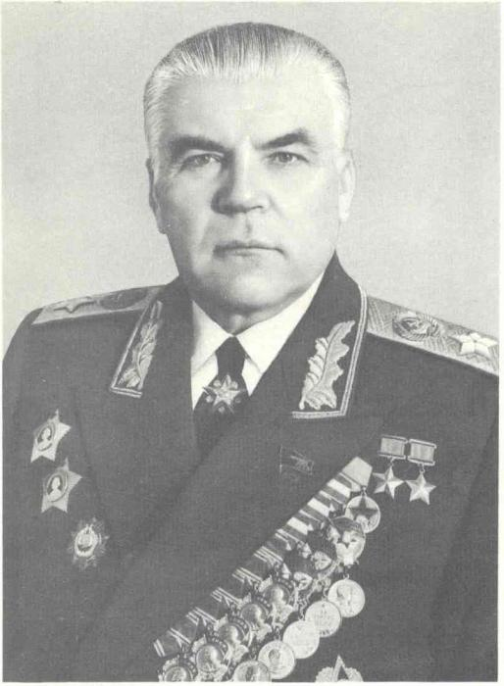
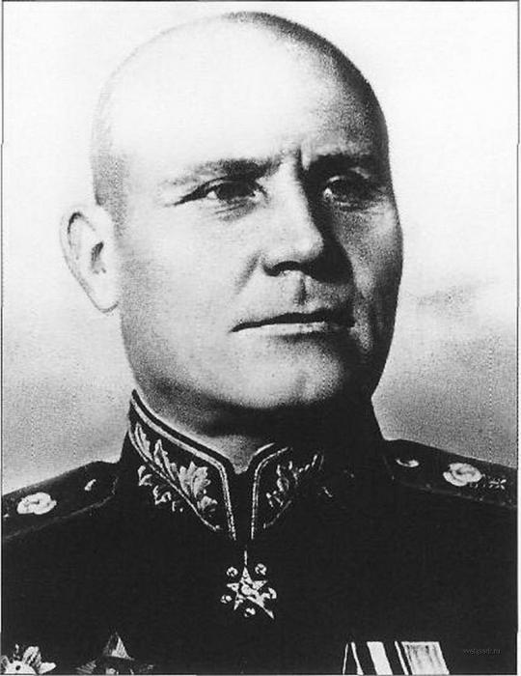
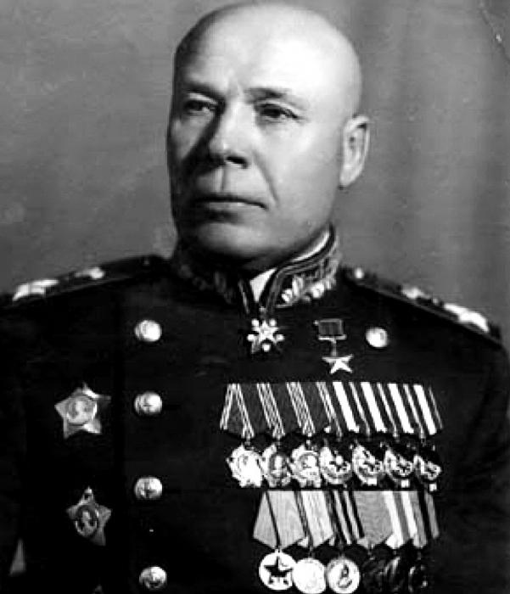
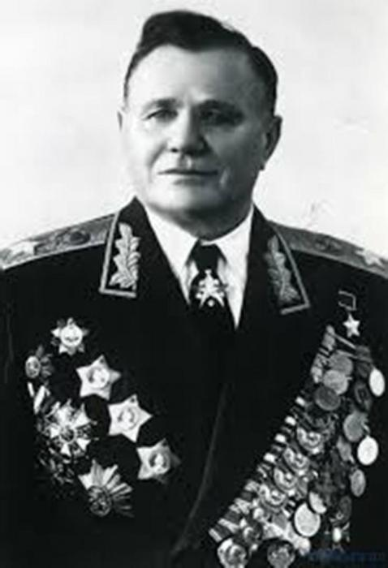
Our generals

Slide 11
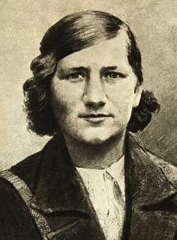
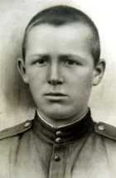
Young generation
At the beginning of The Great Patriotic War thousands of young soviet patriots have gone to fight against German invaders. The remarkable heroes came out of the young people and they conquered the profound love of all soviet people. The exploits of Zoya Kosmodemyanskaya, Lisa Tchaikina, Uriy Smirnov, Nikolay Kuznetsov went down into the history of Russia. Patriotism, friendship of all soviet people contributed to the victory over the fascism.
The young patriots went to the front as volunteers. Komsomol mobilized about 900 000 komsomols during first three days of the war. They performed such exploits which all people admire. The first heroes of the Soviet Union were pilots-komsomols Stepan Zdorovtsov, Petr Kharitonov and Mikhail Zhukov. Over 3 000 000 of komsomols were honored with medals. Over 1 500 of young komsomols were honored with a title the Hero of the Soviet Union. The exploits or these heroes will always dwell in memory of our people and future generations.

Slide 12
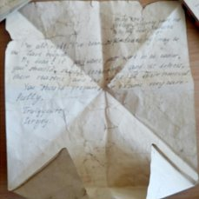
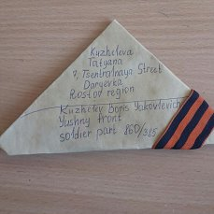
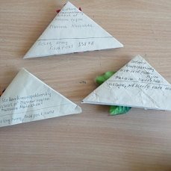
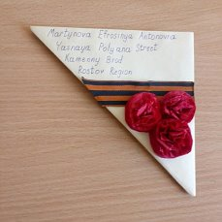
Письма с фронта

Slide 13
Стихи о войне
Александр Твардовский
Перед войной
Перед войной, как будто в знак беды, Чтоб легче не была, явившись в новости, Морозами неслыханной суровости Пожгло и уничтожило сады.
И тяжко было сердцу удрученному Средь буйной видеть зелени иной Торчащие по-зимнему, по-черному Деревья, что не ожили весной.
Под их корой, как у бревна отхлупшею, Виднелся мертвенный коричневый нагар. И повсеместно избранные, лучшие Постиг деревья гибельный удар…
Прошли года. Деревья умерщвленные С нежданной силой ожили опять, Живые ветки выдали, зеленые…
Прошла война. А ты все плачешь, мать.
Константин Симонов
РОДИНА Касаясь трех великих океанов, Она лежит, раскинув города, Покрыта сеткою меридианов, Непобедима, широка, горда.
Но в час, когда последняя граната Уже занесена в твоей руке И в краткий миг припомнить разом надо Все, что у нас осталось вдалеке,
Ты вспоминаешь не страну большую, Какую ты изъездил и узнал, Ты вспоминаешь родину – такую, Какой ее ты в детстве увидал.
Клочок земли, припавший к трем березам, Далекую дорогу за леском, Речонку со скрипучим перевозом, Песчаный берег с низким ивняком.
Вот где нам посчастливилось родиться, Где на всю жизнь, до смерти, мы нашли Ту горсть земли, которая годится, Чтоб видеть в ней приметы всей земли.
Да, можно выжить в зной, в грозу, в морозы, Да, можно голодать и холодать, Идти на смерть… Но эти три березы При жизни никому нельзя отдать. 1941г.

Slide 14
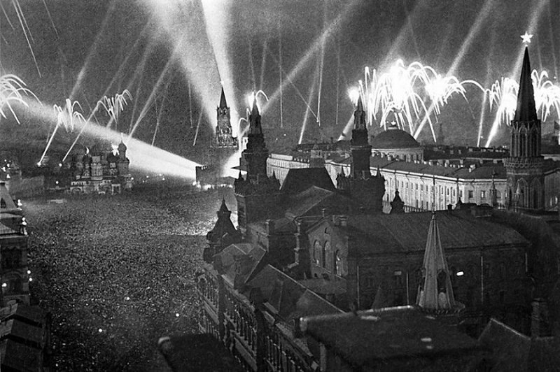
The 9th of May 1945
The Act of Military Surrender was signed on May, 8, 1945. Why then is Victory Day celebrated on the 9th of May?
After the signing of Military Surrender some Nazi forces still remained on the territory of Czechoslovakia in Prague. The Soviet tank units rushed quickly there and on the 9thof May liberated Prague. That’s why we celebrate Victory Day on the 9th of May.

Slide 15
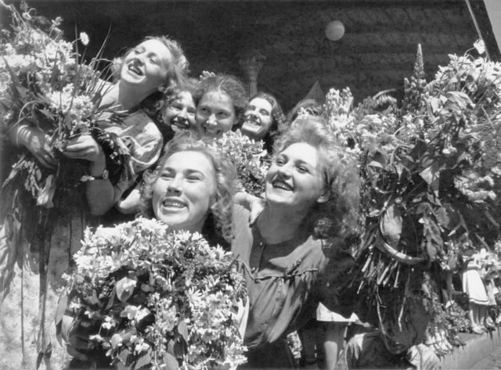
«Возвращались солдаты с войны…»
With soldiers coming back from war,
All around clock the troop – trains roar,
The soldiers coming back from war,
As in a dream through Moscow pour.
Now back from war the old men come
And fathers, who are still quite young.
Back to Siberia they come,
The men who fish and trap and hunt.
Who drive machineries, who know
In peaceful valleys what to grow –
The giant – people now return…
Returning?
No!
The victor – people
Forward go!

